Slide 1
DP
DEVPULSE
DevPulse
See what your code change could break — before you ship it.
AI-POWERED CODE IMPACT INTELLIGENCE
MUNIPALLI SAHITHYA
Vignan's Lara Institute of Technology & Science

Slide 2
DP
DEVPULSE
02 / 12
THE PROBLEM
One small change. Hidden consequences.
In large software projects, even a small code change can ripple across many hidden, connected parts of the system.
TODAY: THE MANUAL WAY
1
Search the codebase
Files
Modules
2
Trace dependencies
APIs
Dependencies
3
Find affected components
Tests
Configuration
Connected components
4
Identify relevant tests
5
Investigate risks
Dependencies are often hidden across the repository — a developer can change one file without knowing what else may be affected.
6
Decide if change is release-ready
DevPulse — AI-Powered Code Impact Intelligence

Slide 3
03 / 12
THE CENTRAL QUESTION
Traditional AI coding tools ask:
“How can I write this code?”
DevPulse asks:
“What could this code change affect?”
DevPulse — AI-Powered Code Impact Intelligence

Slide 4
DP
DEVPULSE
04 / 12
HOW DEVPULSE WORKS
One workflow, five stages
1
2
3
4
5
UNDERSTAND
IMPACT
RISK
TEST
RELEASE
Understand the repository structure
Identify direct and transitive impact
Highlight areas to investigate
Recommend relevant tests
Provide a release-readiness view
A single connected workflow — from understanding a repository to a confident release decision.
DevPulse — AI-Powered Code Impact Intelligence

Slide 5
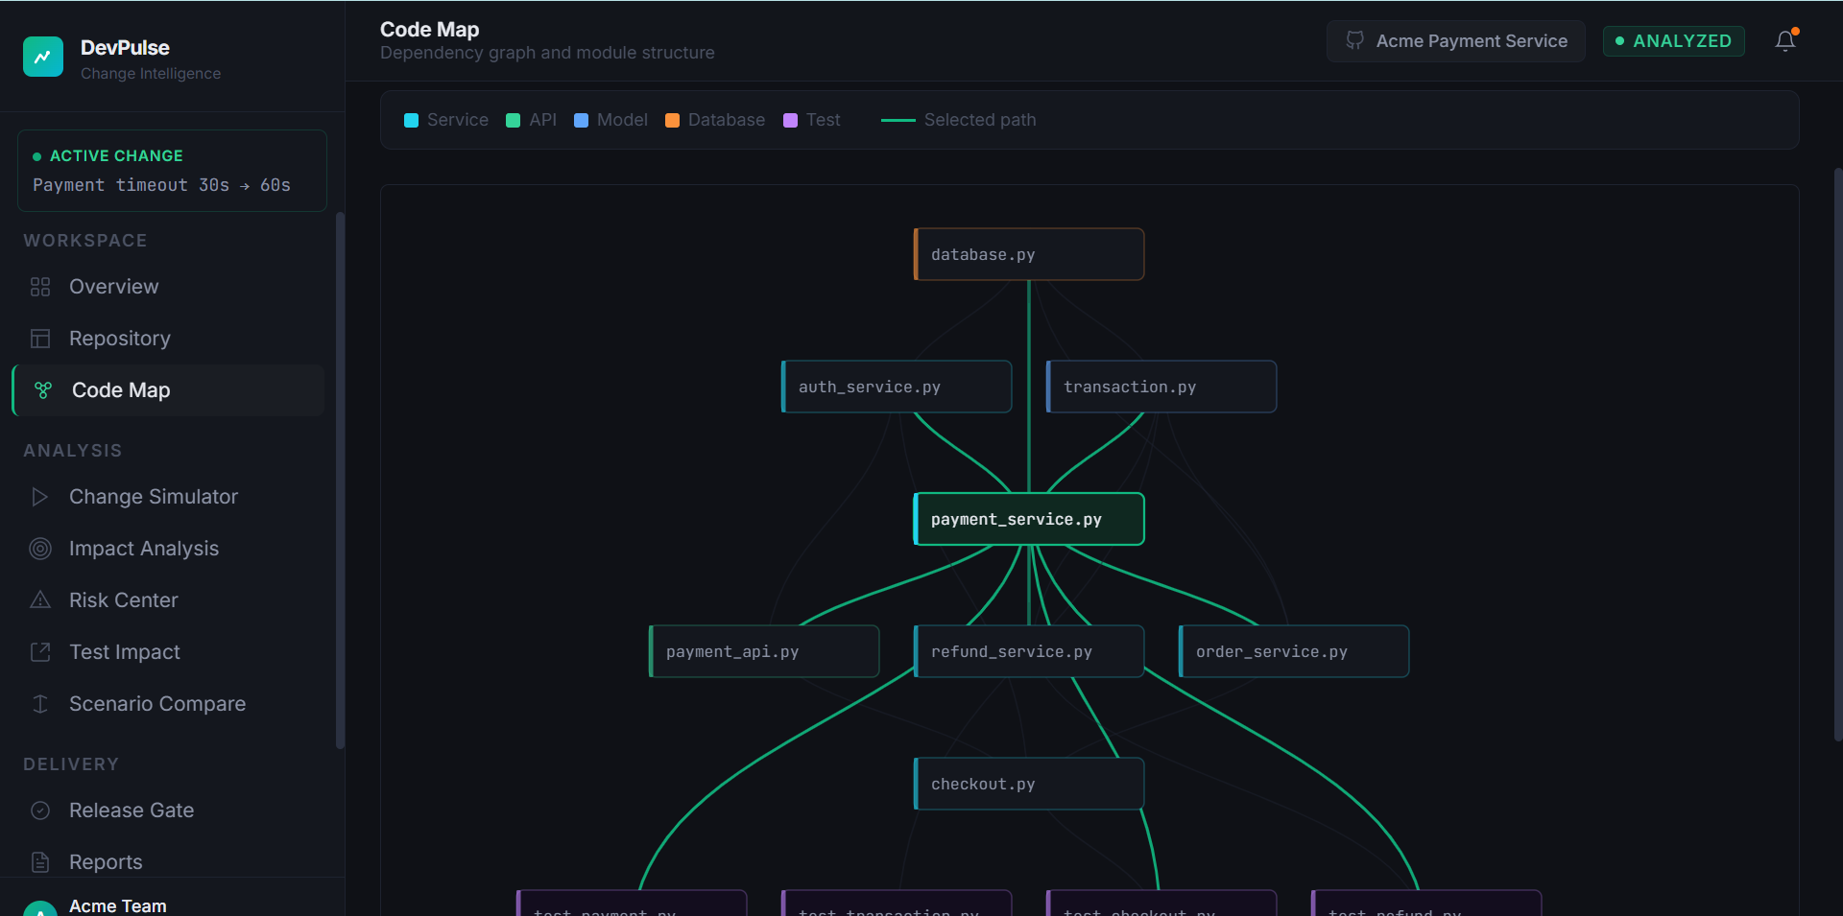
DP
DEVPULSE
05 / 12
REPOSITORY INTELLIGENCE
Acme Payment Service — a live code map
Demo repository used throughout this walkthrough. It contains components spanning the full payment flow:
CODE MAP — LIVE PROTOTYPE
Payment
Transaction
Checkout
Refund
Authentication
Database
Order
Actual screenshot from the DevPulse prototype, visualizing the demo repository above — not yet parsed from a live GitHub connection.
DevPulse — AI-Powered Code Impact Intelligence

Slide 6
DP
DEVPULSE
06 / 12
CHANGE SIMULATOR
Describe a change. See the ripple effect.
PROPOSED CHANGE
HIGH
"Increase payment timeout from 30 seconds to 60 seconds in the core payment
processing logic to reduce false timeout failures under high load."
7
5
68
28%
Files affected
Modules
Risk score
Coverage gap
Actual output from the DevPulse prototype, analyzing the demo repository — not measured real-world production performance.
DevPulse — AI-Powered Code Impact Intelligence

Slide 7
DP
DEVPULSE
07 / 12
IMPACT · RISK · TEST
Understand the blast radius
Direct Impact
Transitive Impact
Test Impact
Components directly connected to the changed component.
Components affected through dependency relationships.
Tests that may need to be checked or updated.
EVERY FINDING EXPLAINS:
WHAT is affected
WHY it is affected
WHAT should be checked
RISK AREAS DEVPULSE HIGHLIGHTS FOR INVESTIGATION
Correctness
Reliability
Performance
Security
Compatibility
DevPulse — AI-Powered Code Impact Intelligence

Slide 8
DP
DEVPULSE
08 / 12
RELEASE READINESS
One dashboard before you ship
68
28%
NOT READY
RISK SCORE
COVERAGE GAP
RELEASE STATUS
RELEASE GATE FINDINGS
✓
Dependency analysis completed
✓
Required tests identified
✗
Required tests updated — 2 required tests must be updated before release (FAIL)
⚠
Risk score of 68 — review recommended before shipping
Actual output from the DevPulse prototype, analyzing the demo repository.
DevPulse — AI-Powered Code Impact Intelligence

Slide 9
DP
DEVPULSE
09 / 12
THE DIFFERENTIATOR
Why DevPulse is different
TRADITIONAL AI CODING TOOLS
DEVPULSE
"How can I write
this code?"
"What could this
code change affect?"
Focused on Code Generation
Focused on Code Impact Intelligence
A developer decision-support system
Impact
Risk
Tests
Release Readiness
DevPulse — AI-Powered Code Impact Intelligence

Slide 10
DP
DEVPULSE
10 / 12
BUILT WITH IBM BOB
Development workflow & technology stack
IBM BOB DEVELOPMENT WORKFLOW
Developer
Idea
IBM Bob
Implementation
Testing
Debugging
Refinement
DevPulse
IBM Bob supported project setup, UI development, feature implementation, component development, debugging, code refinement, and iterative improvements. Session evidence maintained in bob_sessions/.
TECHNOLOGY STACK
Frontend
React
TypeScript
Vite
Modular Service-Oriented Architecture
Repository Service
Code Analysis Service
Dependency Graph Service
Impact Analysis Service
Risk Analysis Service
Test Impact Service
Report Service
AI Analysis Service
DevPulse — AI-Powered Code Impact Intelligence

Slide 11
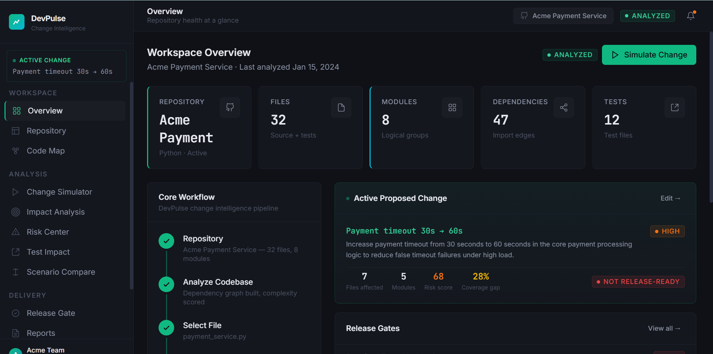
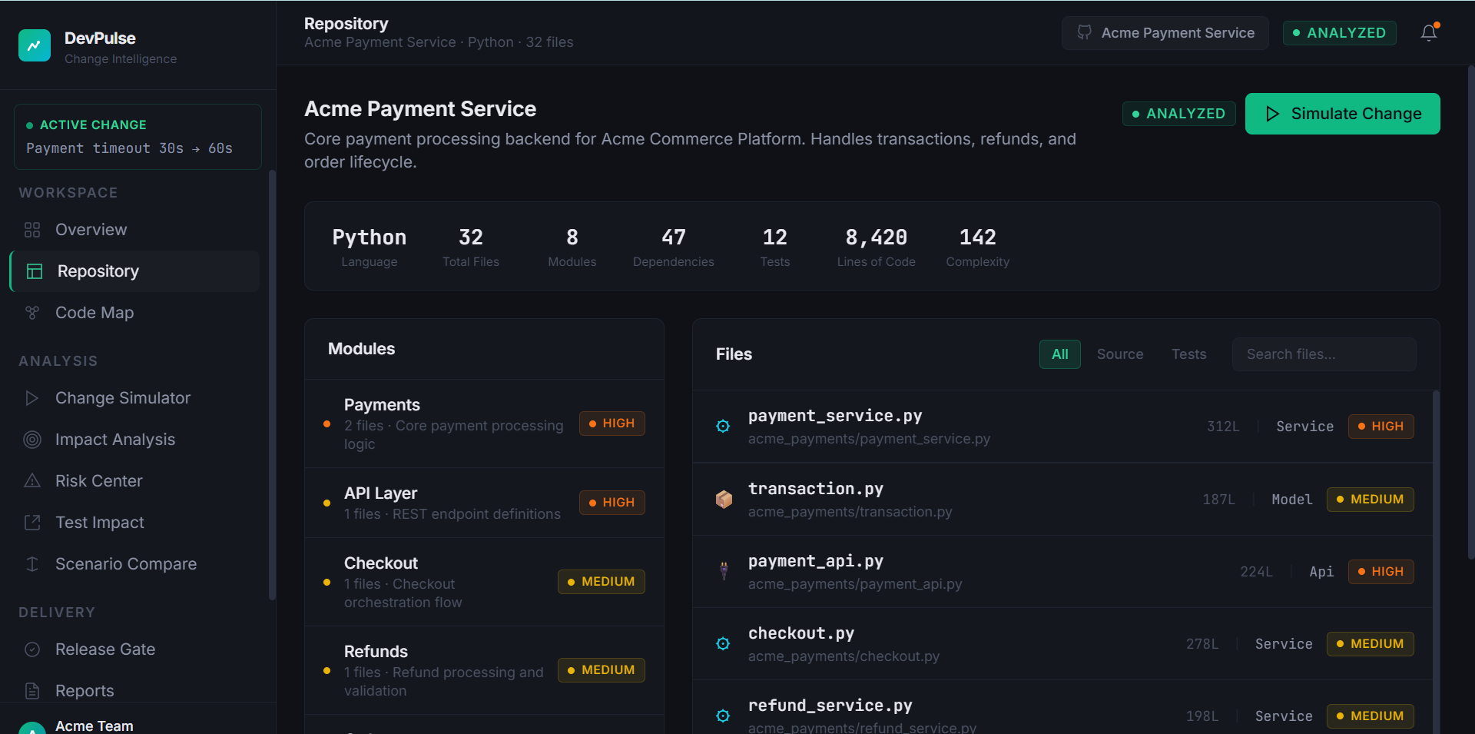
DP
DEVPULSE
11 / 12
LIVE PROTOTYPE
See Code Impact Intelligence in action
Workspace Overview
Repository Intelligence
Code Map
Health, active change, and workflow at a glance
Modules, files, and complexity metrics
Live dependency graph visualization
Demo sequence: Acme Payment Service → Code Map → payment_service.py → Change Simulator → Impact & Risk → Recommended Tests → Release Gate.
DevPulse — AI-Powered Code Impact Intelligence

Slide 12
DP
DEVPULSE
12 / 12
FUTURE DEVELOPMENT
The long-term vision
GitHub Repository
Code Analysis
Dependency Intelligence
Change Impact
AI Explanation
Risk
Tests
Release Gate
• Automatic code parsing (Python, JS, TS)
• Real dependency extraction
• Pull-request analysis
• CI/CD integration
• Automated impact reports
• Team collaboration
• Historical change intelligence
DevPulse
MUNIPALLI SAHITHYA
See what your code change could break — before you ship it.
Vignan's Lara Institute of Technology & Science

